Slide 1

BUS7C3 International Organisational Branding
Lecture 5 – Employee Value Proposition and Analysis

Slide 2

Week 4 Recap
Employer branding models and positioning
Employer branding value chain model
Theoretical position of Employer Branding

Slide 3
Learning Outcomes
By the end of this lecture you will be able to:
Explain employee value propostion
Analyse its impact from a strategic and management organisational perspective
Critically evaluate EVP and Employer Branding
Apply EVP and Employer Branding in a business context

Slide 4
Future Employment Challenges
?
Skills shortages will be evident in the next few years – causing a skills crisis
Employees will want to attract and retain talent
?
Remote and hybrid working is changing the employment landscape. Choice sits with the employee
Tech is one industry that will see a mass exodus
?
Looking for employees who support them in and out of the office/workplace
Gen Z is prioritizing purpose and impact over wages/salary
Evaluating potential employers’ values and ensuring they align to their own values.

Slide 5
What is an Employee Value Proposition (EVP)?
EVP is balance of employee rewards and benefits in return for performance and
high performance and employee engagement. It is what an organization delivers to
employees in return for the organisational contribution those employees make.
Rewards
Benefits
Performance

Slide 6
EVP Further Discussed….
Employee’s Value Proposition can be used as an effective tool of employment branding as it outlines the desired and desirable requisites of employees related to employment, with employee’s value proposition now being the most tactful employment branding tool by organisations as it is reflected on all efforts of hiring and retaining talent (Deshpande, 2019).
Organisations need to excel for survival. This is why people are its greatest asset.

Slide 7
Creating EVP
Understand how people see your business/company/organisation: what is it that people value and are motived by.
How is your business/company/organisation perceived by others? Rejected candidates, stakeholders, clients?
Consider external review sites: what are they saying about you?
People want different things from an employer: remember to vary rewards and benefits, to make them more attainable to all.
Remember! The employee experience is constantly changing.

Slide 8
EVP and Employer Branding
Global brands such as Google, Apple etc. did not start their company based on logos, or memes, or tunes. Their starting point was understanding what people – consumers wanted and creating a product offering.
EVP takes this and develops an attractive package for recruiting and retaining employees and key talent. This is part of a wider strategic focus, which aligns with a company’s values, culture, mission, goals, objectives as well as HR, corporate and business strategies. A strong EVP can also re-engage, re-energise and re-motivate a disillusioned workforce.
Armstrong (2006), states that, the objective of employer branding is to become an 'employer of choice' where people desire to work.

Slide 9
EVP 3-Stage Process: Backhaus & Tikoo (2004), have developed a 3-stage process:
Step 1
An organization develops a concept of the value it offers to its potential and existing employees. This value proposition is communicated as the key message through employer branding.
Step 2
Step 3
External marketing of employer value proposition to attract suitable candidates.
Internal marketing of the employer brand to develop a committed workforce towards the achievement of organizational goals.

Slide 10
EVP and Employer Branding Focus….
EVP and Employer Branding focusses on the key themes you are already investigating:
Talent attraction (recruitment)
Retention
Reward
Conduct
This culminates in engagement activities and initiatives that influence an employee’s view on an organisation, thus shaping its employer brand and highlighting it as a place to work – an employer of choice. This is how organisations market their EVP to current and prospective employees, and to attract and maintain loyalty.

Slide 11
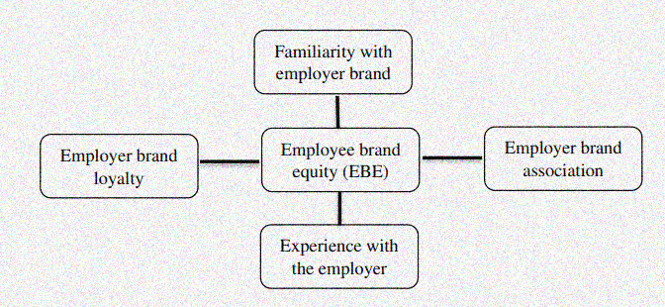
Dimensions of Employee Brand Equity

Slide 12
Group Activity
Your future wishlist
In your groups I want you to discuss what your employment wish list would look like.
How would you like to be employed?
What type of environment or culture would you like to work in?
What type of development would you like to receive?
How quickly would you like promotion?
What is your ideal job role, and how quickly do you aim to get there?
What financial and non-financial benefits would you like to receive?
What would be the ultimate reward or benefit that would encourage you to work for a bad employer?

Slide 13
Group Activity
Now think about how you would develop this as an employee proposition value and employer brand. As a manager how would you use these insights to develop your employer brand? What type of offer would you make to potential employees and how would you sell your brand to make it attractive?

Slide 14

Thank you!
Any questions?

